Slide 1

PIZZA SALES DATA ANALYSIS USING SQL
Presented by : Priya Bag

Slide 2

PROJECT OVERVIEW
The Pizza Sales Data Analysis project focuses on analyzing pizza sales data using Structured Query Language (SQL) to extract meaningful business insights.
The project involves working with a relational database containing information about customer orders, pizza details, pizza categories, prices, and order quantities.
By executing SQL queries, the project analyzes sales performance, customer ordering patterns, popular pizza varieties, revenue distribution, and sales trends over time.
The primary objective is to transform raw sales data into meaningful insights that can help businesses understand their sales performance and make better data-driven decisions.
PROJECT OBJECTIVE
  Calculate total orders and overall revenue.
  Identify the most popular pizza types and sizes.
  Analyze sales performance across different pizza categories.
  Understand customer ordering patterns by hour and date.
  Identify top-performing pizzas based on revenue.
  Evaluate individual pizza contributions to total revenue.
  Analyze cumulative revenue trends over time.

Slide 3
PROJECT APPROACH
DATABASE EXPLORATION
DATA UNDERSTANDING
SQL QUERY DEVELOPMENT
  Explored the pizzahub database and understood the structure of its four tables: orders, order_details, pizzas and pizza_types.
  Examined table columns, relationships, primary keys and foreign keys to understand how the sales information was organized.
  Developed SQL queries using aggregate functions, joins, GROUP BY, ORDER BY, subqueries and window functions to retrieve relevant information
DATA ANALYSIS
INSIGHTS AND INTERPRETATION
  Performed basic and advanced analysis to identify sales trends, popular products, revenue contributions and customer ordering patterns.
  Interpreted query results to understand business performance and identify the products and categories contributing most to sales.

Slide 4
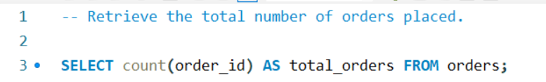
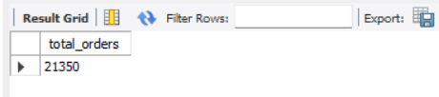
1) Retrieve the total number of orders placed.
QUERY:
OUTPUT:

Slide 5
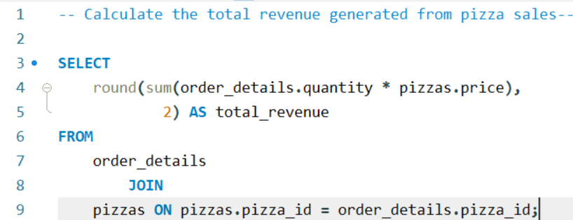
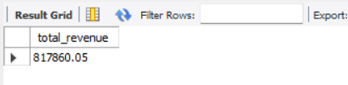
2) Calculate the total revenue generated from pizza sales.
QUERY:
OUTPUT:

Slide 6
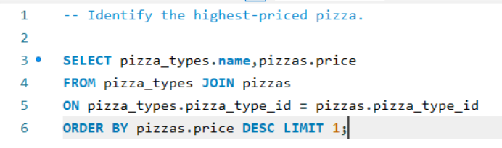
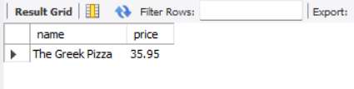
3) Identify the highest-priced pizza.
QUERY:
OUTPUT:

Slide 7
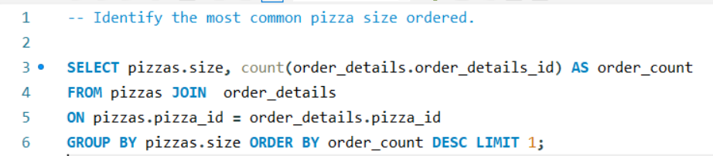
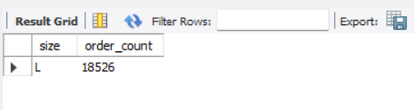
4) Identify the most common pizza size ordered
QUERY:
OUTPUT:

Slide 8
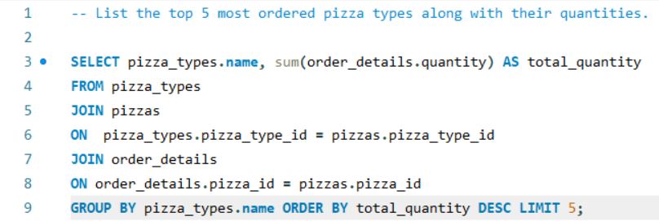
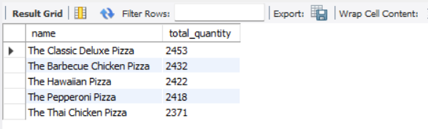
5) List the top 5 most ordered pizza types along with their quantities.
QUERY:
OUTPUT:

Slide 9
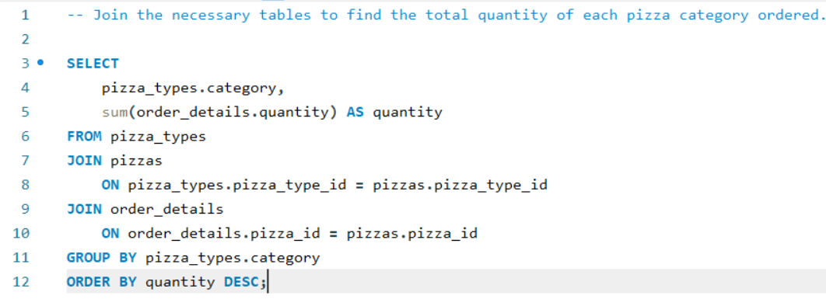
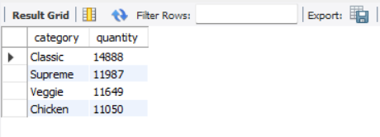
6) Join the necessary tables to find the total quantity of each pizza category ordered.
QUERY:
OUTPUT:

Slide 10
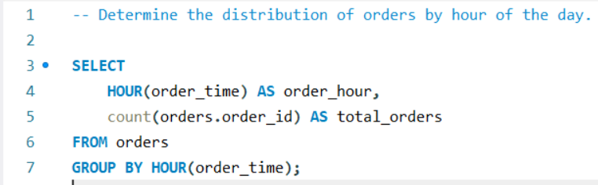
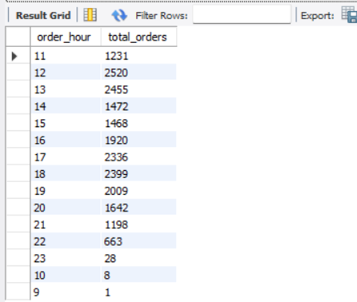
7) Determine the distribution of orders by hour of the day
QUERY:
OUTPUT:

Slide 11
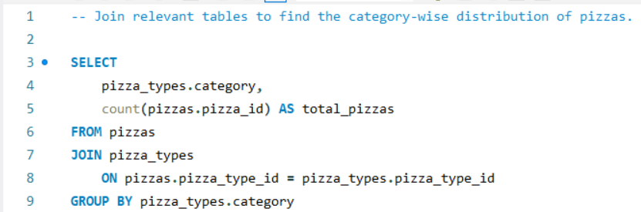
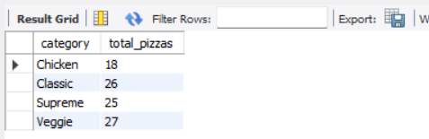
8) Join relevant tables to find the category-wise distribution of pizzas.
QUERY:
OUTPUT:

Slide 12
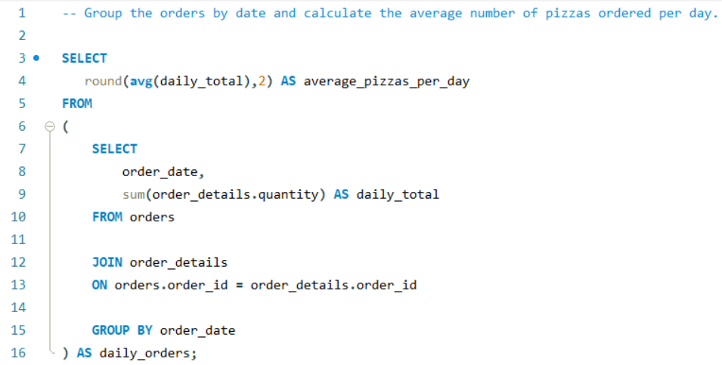

9) Group the orders by date and calculate the average number of pizzas ordered per day.
QUERY:
OUTPUT:

Slide 13
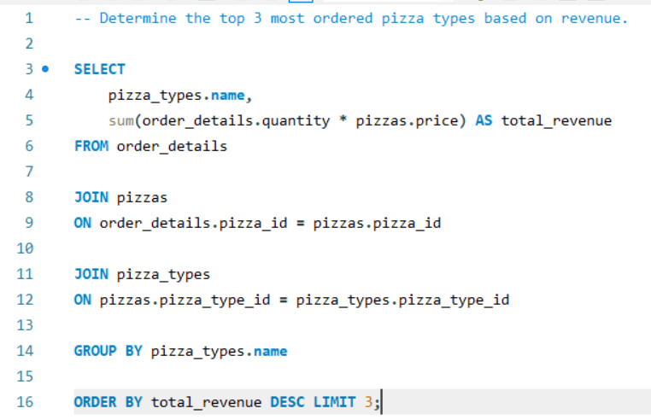
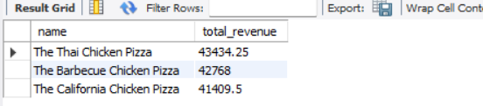
10) Determine the top 3 most ordered pizza types based on revenue.
QUERY:
OUTPUT:

Slide 14
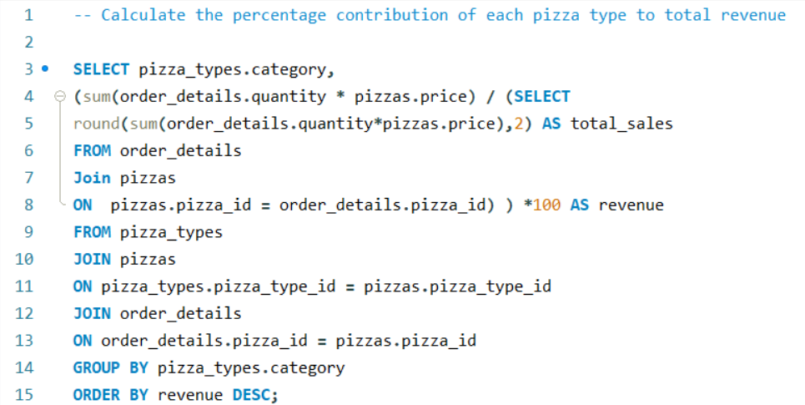
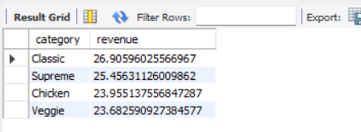
Calculate the percentage contribution of each pizza type to total revenue.
11)
QUERY:
OUTPUT:

Slide 15
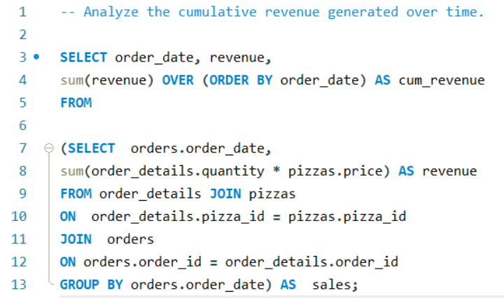
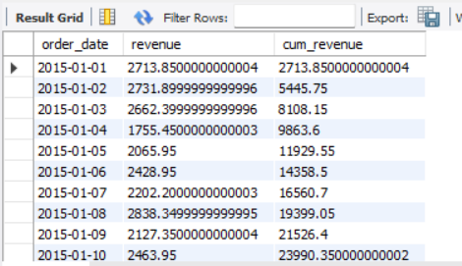
12) Analyze the cumulative revenue generated over time.
QUERY:
OUTPUT:

Slide 16
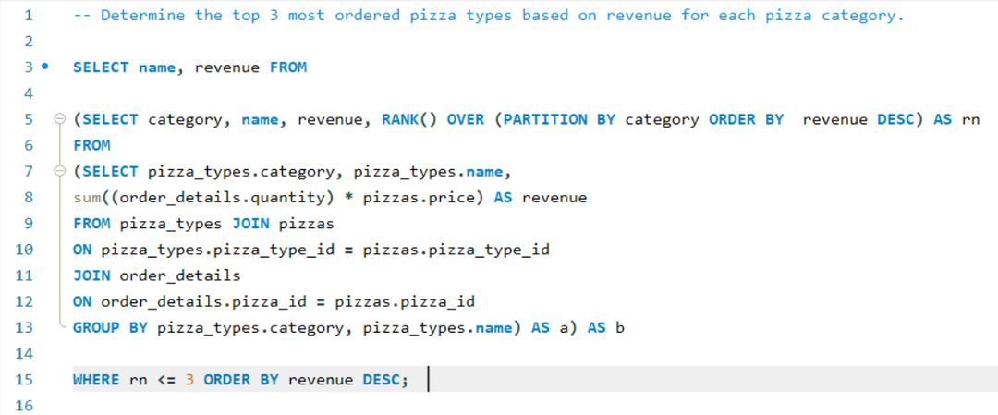
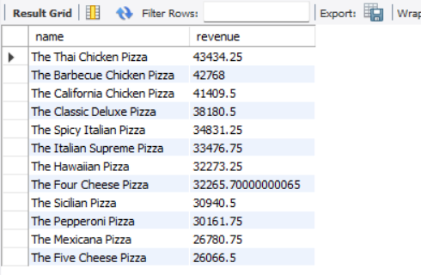
13) Determine the top 3 most ordered pizza types based on revenue for each pizza category.
QUERY:
OUTPUT:

Slide 17

THANK YOU

